Slide 1

Las Vegas Explorer App

Slide 2

Elevator pitch
We have created a web page to help the user to find flight, hotels, restaurants, sports activities, concerts, etc. when user starts to plan a trip to Las Vegas.

Slide 3
Concept
Technologies used:
Bootstrap, Framework, Google Fonts, Server Side API with JSON, JQuery, Local Storage, Media Queries, and Event Listeners.
Breakdown of tasks and roles
Jamie: End Page
Julio: Ticketmaster Page
Harry: Form Page
Ozdal: Main page
Stanislav: Fullhouse and Royalflush pages
Challenges
To work as a real team with Github Collaboration.
To create a working page, created by different team members, finding API’s.
Most importantly: Working with other humans!
Successes
Learned how to work together without conflicts in GitHub.
We adapted our personal expectations for the greater good of the team.
We evaluated our project midway and reconciled our various directions.
We started out as incorrigible mavericks but ended as a team!

Slide 4
Process
Technologies used:
We would like to create an organizer so users can book, buy, rent what they want before going to Las Vegas.
Motivation for development?
Showcase our ability to collaborate and develop a web-site employing API technology!
User story
When the user goes to the Main Page there are 4 options; Basic, Premium, Customize or straight to the Events API. The Events API leads them to the Ticketmaster web-site, where the user can search for some shows and activities.
When the user wants to organize the Las Vegas trip, the user needs to go Basic, Premium or Customize pages. In the Basic Page, the user finds hotels, restaurants, flights etc. The Premium Page works the same way, but the user can find more luxury options. Finally, in the Customize Page, the user can display, and select both Basic and Premium options.

Slide 5
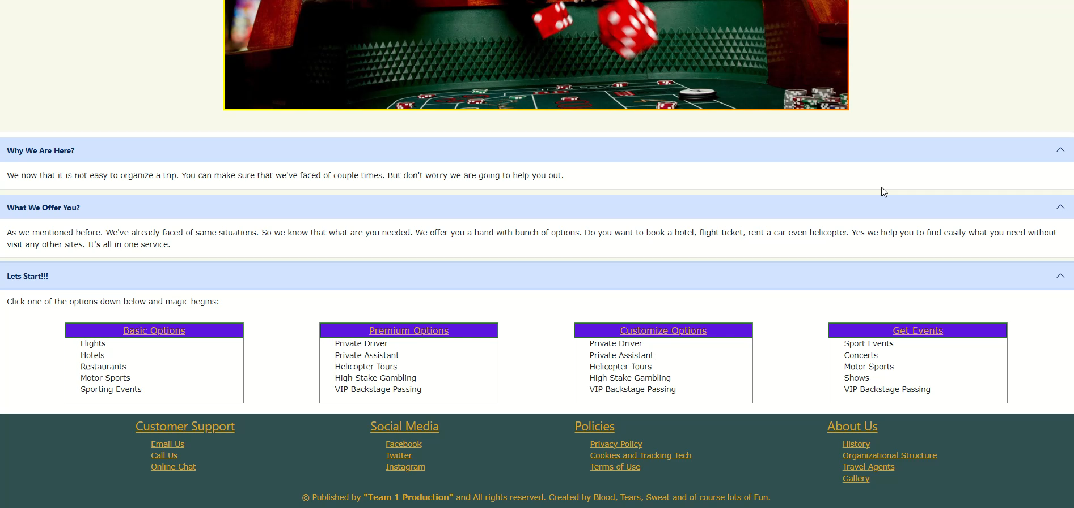
Demo

Slide 6
Future Development
Constantly review and update appearance of web page.
Review and modifying codes to make them more efficient and a more stabile webpage.
Upgrading web page, design, and its content to become a web page of a sales focused/oriented company.
Expand APIs that we use.
Make decisions based on user feedback!

Slide 7
Links
Deployed
https://ozdaldogru.github.io/Las-Vegas-Trip-Organizer/
GitHub repo link:
https://github.com/ozdaldogru/Las-Vegas-Trip-Organizer
Github HTTPS link:
https://github.com/ozdaldogru/Las-Vegas-Trip-Organizer.git

Slide 8
Thanks !!!

